Slide 1
OpenAPI for .NET Developers

Slide 2
Agenda
Terminology
OpenAPI Intro
Build web APIs with ASP.NET Core (recap)
Demos of different code generation approaches

Slide 3
OpenAPI Initiative (OAI)
created by a consortium of industry experts (SmartBear, 3Scale, Apigee, Capital One, Google, IBM, Intuit, Microsoft, PayPal, and Restlet)
an open governance structure under the Linux Foundation
focused on creating, evolving and promoting a vendor neutral description format of REST APIs
Notes:
Example objectives
At the end of this lesson, you will be able to:
Save files to the team Web server.
Move files to different locations on the team Web server.
Share files on the team Web server.

Slide 4
OpenAPI Spec (OAS)
SmartBear donated the Swagger Specification in 2015 as part of the formation of the Open API Initiative
Swagger Specification was renamed to OpenAPI Specification
OpenAPI Specification is semantically identical to the specification formerly known as the Swagger 2.0 specification
may be represented either in JSON or YAML (with restrictions) format
the latest version is OpenAPI 3.0.2
Notes:
Example objectives
At the end of this lesson, you will be able to:
Save files to the team Web server.
Move files to different locations on the team Web server.
Share files on the team Web server.

Slide 5
Swagger Sample
swagger: "2.0"
info:
title: Sample API
description: API description in Markdown.
version: 1.0.0
host: api.example.com
basePath: /v1
schemes:
- https
paths:
/users:
get:
summary: Returns a list of users.
description: Optional extended description in Markdown.
produces:
- application/json
responses:
200:
description: OK

Slide 6
Data Types
OpenAPI defines the following basic types:
string
number
integer
boolean
array
object
An optional format can define more specific type.
https://swagger.io/docs/specification/data-models/data-types/

Slide 7
type | format | .NET Type | Description
number | - |  | Any numbers.
number | float/double | System.Single/System.Double | Floating-point numbers.
integer | - |  | Integer numbers.
integer | int32/int64 | System.Int32/System.Int64 | Signed 32/64-bit integers.
string | - | System.String
string | date | System.DateTime | Full-date notation, for example, 2017-07-21.
string | date-time | System.DateTime | The date-time notation, for example, 2017-07-21T17:32:28Z.
string | password | System.String | A hint to UIs to mask the input.
string | uuid | System.Guid
string | uri | System.Uri

Slide 8
OpenAPI Tools
Explore
Swagger UI
ReDoc
dotnet httprepl
Consume
Swagger Codegen
NSwag
Create
Swagger Editor
Swashbuckle
NSwag
AutoRest

Slide 9
WebAPI in ASP.NET Core
Derive from ControllerBase
ControllerBase - a base class for an MVC controller without view support
Controller (inherited from ControllerBase) adds view support
View()
PartialView()
ViewComponent()
Json()

Slide 10
WebAPI in ASP.NET Core
Annotate with ApiController attribute (ASP.NET Core 2.1)
Controllers [Route("api/[controller]")] [ApiController] public class ProductsController : ControllerBase
Or assembly (ASP.NET Core 2.2) [assembly: ApiController]
Set compatibility version in Startup.cs services.AddMvc().SetCompatibilityVersion(CompatibilityVersion.Version_2_2);

Slide 11
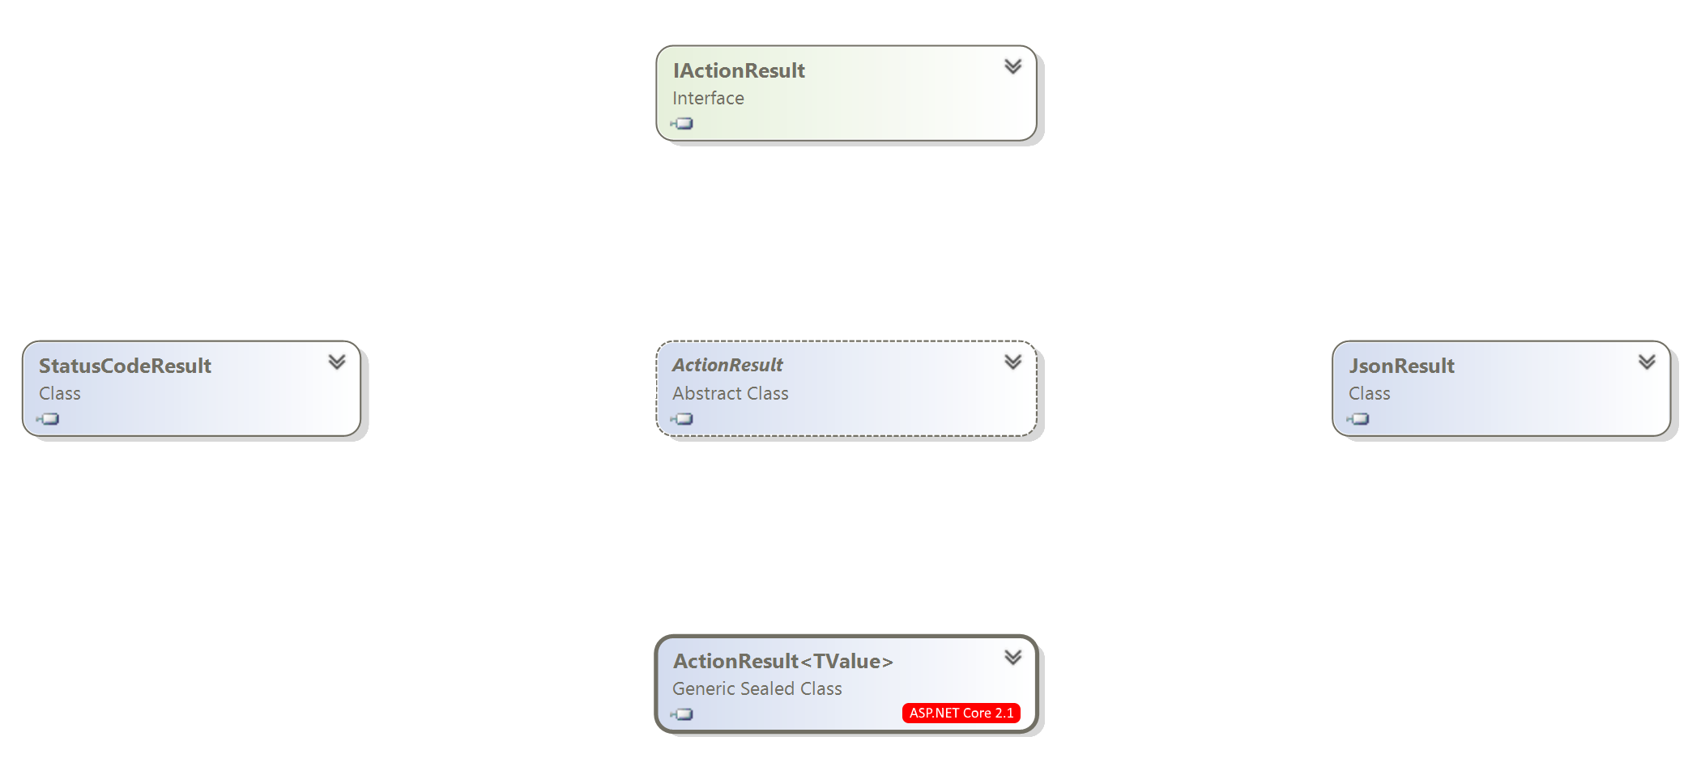
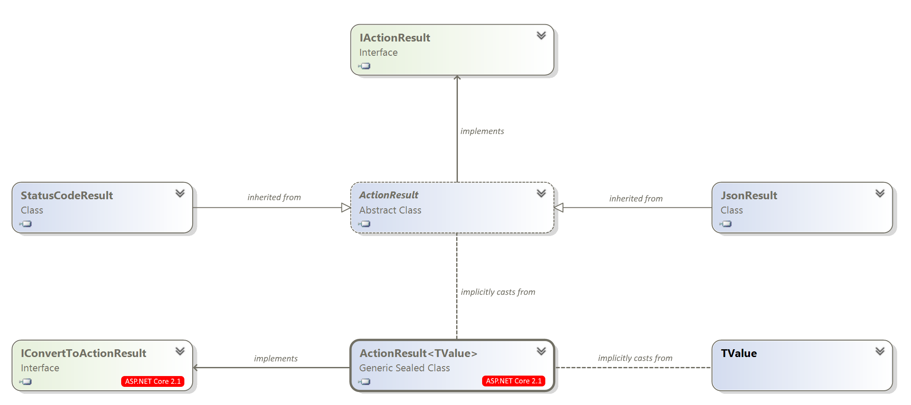
Action Result Types

Slide 12
ActionResult<T>
Enables you to return a type deriving from ActionResult or return a specific type.
ActionResult<T> is not inherited neither from IActionResult nor ActionResult, but provides an implicit cast from ActionResult or any object (System.Object).
[HttpGet("{id}")]
public async Task<ActionResult<Pet>> GetPet(int id)
{
Pet pet = await _petRepository.GetPet(id);
if (pet == null)
{
return NotFound();
}
return pet;
}

Slide 13
ProblemDetails
A standardized format for specifying machine-readable error details in an HTTP response (RFC 7807).
C#
if (product == null) { return NotFound(); }
JSON
{ type: "https://tools.ietf.org/html/rfc7231#section-6.5.4", title: "Not Found", status: 404, traceId: "0HLHLV31KRN83:00000001“ }

Slide 14
Code First
WebAPI
Schema
Clients
Schema First
WebAPI
Schema
Clients
Number of details
more
less

Slide 15
Code First Demo

Slide 16
Add Swagger and SwaggerUI
.csproj:
<ItemGroup>
<PackageReference Include="Swashbuckle.AspNetCore" Version="4.0.1" />
</ItemGroup>
Startup.cs:
public void ConfigureServices(IServiceCollection services)
{
services.AddSwaggerGen();
}
public void Configure(IApplicationBuilder app)
{
app.UseSwagger();
app.UseSwaggerUI();
}

Slide 17
Include xml comments
.csproj:
<PropertyGroup>
<!-- produce $(AssemblyName).xml documentation file -->
<GenerateDocumentationFile>true</GenerateDocumentationFile>
</PropertyGroup>
Startup.cs:
services.AddSwaggerGen(c =>
{
string filePath = Path.ChangeExtension(Assembly.GetExecutingAssembly().CodeBase, ".xml");
c.IncludeXmlComments(filePath);
});
Controller.cs:
/// <summary>Gets the pets.</summary>
[HttpGet]
public async Task<ActionResult<IEnumerable<Pet>>> GetPets() { }

Slide 18
Document non HTTP 200 responses
[HttpPut("{id}")]
[ProducesResponseType(StatusCodes.Status204NoContent)]
[ProducesResponseType(StatusCodes.Status400BadRequest)]
[ProducesResponseType(StatusCodes.Status404NotFound)]
[ProducesDefaultResponseType]
public async Task<ActionResult<Pet>> PutPet(int id, Pet pet)
{
if (id != pet.Id)
{
return BadRequest();
}
Pet updatedPet = await _petRepository.UpdatePet(pet);
if (updatedPet == null)
{
return NotFound();
}
return NoContent();
}
Microsoft.AspNetCore.Mvc.Api.Analyzers nuget package helps finding undocumented response statuses

Slide 19
Clarify data types: Enums
Startup.cs:
public void ConfigureServices(IServiceCollection services)
{
services.AddMvc().AddJsonOptions(o =>
{
o.SerializerSettings.Converters
.Add(new StringEnumConverter());
});
services.AddSwaggerGen(c =>
{
c.DescribeAllEnumsAsStrings();
});
}

Slide 20
Clarify data types: Dates
Model.cs:
[DataType(DataType.Date)] // for schema
[JsonConverter(typeof(DateJsonConverter))] // for json
public DateTime DateOfBirth { get; set; }
swagger.json:
"dateOfBirth": {
"format": "date",
"type": "string"
}
Microsoft.Rest.Serialization.DateJsonConverter from Microsoft.Rest.ClientRuntime nuget package

Slide 21
Polymorphic schemas
Startup.cs:
services.AddMvc().AddJsonOptions(options =>
{
options.SerializerSettings.Converters.Add(
new PolymorphicDeserializeJsonConverter<Pet>("petType"));
});
services.AddSwaggerGen(c =>
{
// Swashbuckle.AspNetCore 5.0.0-rc2
c.GeneratePolymorphicSchemas();
});
Microsoft.Rest.Serialization.PolymorphicDeserializeJsonConverter from Microsoft.Rest.ClientRuntime nuget package

Slide 22
Extract schema using swagger cli
> dotnet swagger tofile [options] [startupassembly] [swaggerdoc]
.csproj:
<ItemGroup>
<DotNetCliToolReference Include="Swashbuckle.AspNetCore.Cli" Version="4.0.1" />
</ItemGroup>
<Target Name="ExtractSwaggerSchema" AfterTargets="Build">
<PropertyGroup>
<SwaggerFile>..\PetStore.ClientApp\swagger.json</SwaggerFile>
</PropertyGroup>
<!-- export swagger schema for v1 as swagger.json -->
<Exec Command="dotnet swagger tofile --output $(SwaggerFile) $(AssemblyName).dll v1" />
</Target>

Slide 23
Generate Angular client
> npm install ng-swagger-gen
> ng-swagger-gen -o src/api/generated -i swagger.json
import { Component } from '@angular/core';
import { PetService } from 'src/api/generated/services';
import { Pet } from 'src/api/generated/models';
import { Observable } from 'rxjs';
@Component({
selector: 'app-home’,
templateUrl: './home.component.html',
})
export class HomeComponent {
public pets$: Observable<Pet[]>;
constructor(petService: PetService) {
this.pets$ = petService.GetPets();
}
}
Do not forget to exclude auto generated code from source control (e.g. .gitignore)

Slide 24
Extensibility via filters
XCorrelationIdFilter.cs:
public class XCorrelationIdFilter : IOperationFilter
{
public void Apply(Operation operation, OperationFilterContext context)
{
operation.Parameters.Add(new NonBodyParameter
{
Name = "X-Correlation-ID",
In = "header",
Type = "string",
Format = "uuid",
});
}
}
Startup.cs:
services.AddSwaggerGen(c =>
{
c.OperationFilter<XCorrelationIdFilter>();
});
Swashbuckle.AspNetCore.SwaggerGen
IParameterFilter
IOperationFilter
IDocumentFilter
ISchemaFilter

Slide 25
Microsoft.AspNetCore.Mvc.ApiExplorer
IApiDescriptionGroupCollectionProvider interface provides programmatic access to the API metadata

Slide 26
Schema First Demo

Slide 27
Create schema
Swagger Editor https://swagger.io/tools/swagger-editor/ (offline version is available)
Swagger Viewer for Visual Studio Code
Any other text editor of your choice

Slide 28
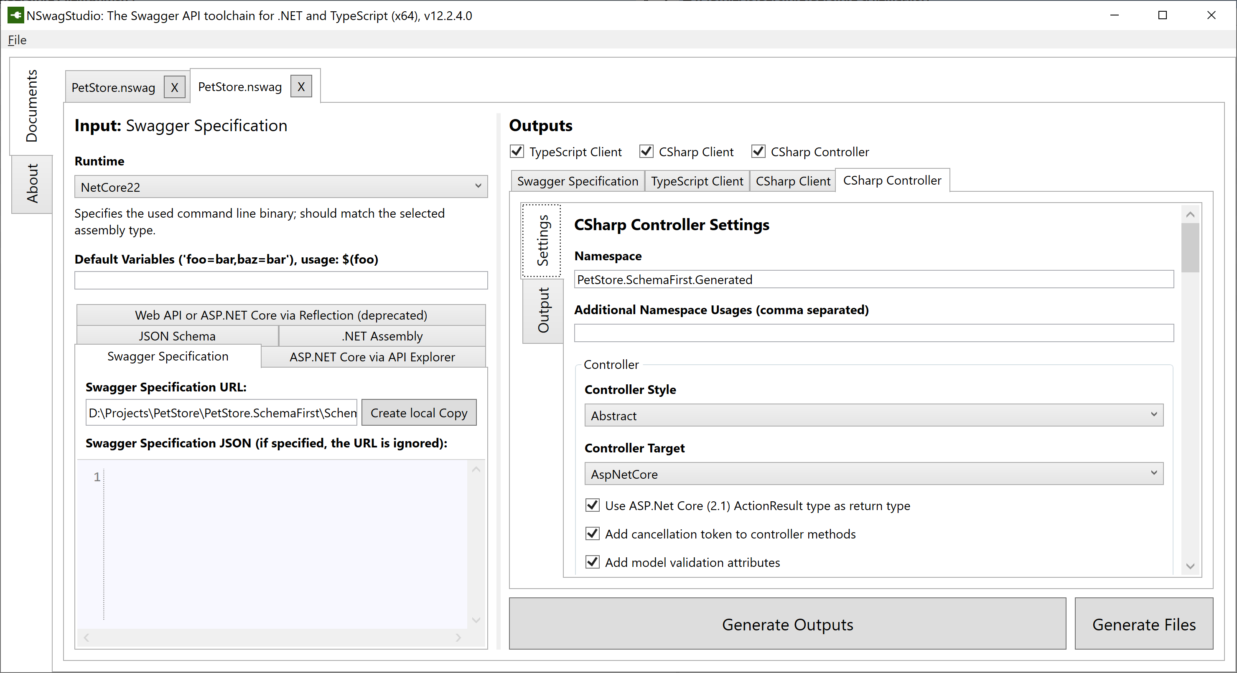
Edit code-gen config in NSwagStudio

Slide 29
Generate server stubs and client implementation(s)
A single command to generate:
Server side stubs (controllers, DTOs)
TypeScript clients (e.g. Angular)
C# clients (via HttpClient)
<ItemGroup>
<PackageReference Include="NSwag.MSBuild" Version="12.2.3" />
</ItemGroup>
<Target Name="NSwag" BeforeTargets="CoreCompile">
<Copy SourceFiles="@(ReferencePath)" DestinationFolder="$(OutDir)References" />
<Exec Command="$(NSwagExe_Core22) run /variables:OutDir=$(OutDir)" />
<RemoveDir Directories="$(OutDir)References" />
<ItemGroup>
<Compile Include="Generated\**" Exclude="@(Compile)" />
</ItemGroup>
</Target>

Slide 30
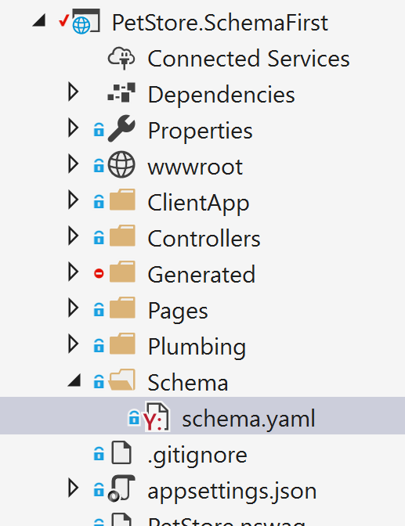
Expose Swagger and SwaggerUI
public void Configure(IApplicationBuilder app, IHostingEnvironment env)
{
// expose handcrafted schema
app.UseStaticFiles(new StaticFileOptions
{
RequestPath = "/Schema",
FileProvider = new PhysicalFileProvider("Schema")),
ServeUnknownFileTypes = true
});
// add SwaggerUI mapped to the schema
app.UseSwaggerUi3(settings =>
{
settings.DocumentPath = "/Schema/schema.yaml";
});
}

Slide 31
Code First vs Schema First
Code First
Schema First
Easy to start with an existing API
Serialization rules and schema are out of sync
Code generation quality drops after each hop
Flexible versioning
Common parameters in request/response could be easily automated
Design first, contract first
Code is derived from schema
Better overall quality of code generated code
Versioning via copy-paste-edit
Lots of duplication in case of common parameters in request/response

Slide 32
Summary
OpenAPI helps you build self-documented web APIs
Standardized schema lets you connect your APIs with other tools like code and documentation generators
Code First or Schema First are easy to apply with tools like Swashbucke.AspNetCore or NSwag

Slide 33
Resources
OpenAPI https://www.openapis.org/ https://swagger.io/
Create web APIs with ASP.NET Core https://docs.microsoft.com/en-us/aspnet/core/web-api/
Swashbuckle.AspNetCore https://github.com/domaindrivendev/Swashbuckle.AspNetCore
NSwag https://github.com/RicoSuter/NSwag
Demos https://github.com/altso/pet-store

Slide 34
Questions?

Slide 35
Thank you

